Slide 1
Checksum
IP, TCP, UDP

Slide 2
Checksum
To create the checksum, the sender does the following:
  The packet is divided into k sections, each of n bits.
  All sections are added together using 1’s complement arithmetic.
  The final result is complemented to make the checksum.
- <number> -

Slide 3
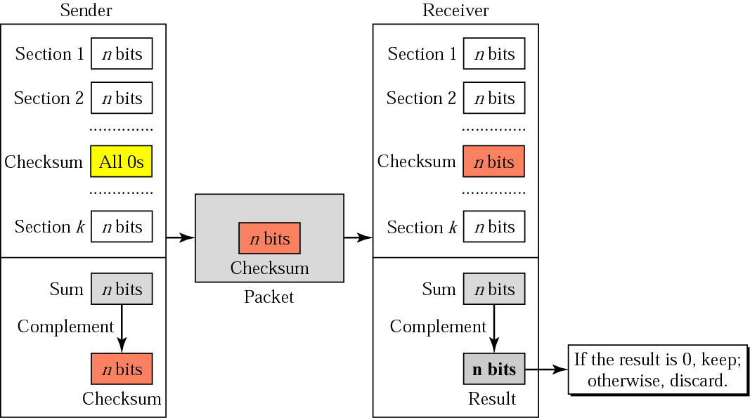
Checksum Concept
- <number> -

Slide 4
1’s complement
What is 1’s complement addition?
  Sum the numbers normally
  The carry of the sum is whatever bits are to the left of the rightmost 16 bits.
  If carry=0 then the normal sum is the 1’s complement sum. If carry!=0 then add the carry back into normal sum to get 1’s complement sum.
  Examples next slide use 8 bits
- <number> -

Slide 5
Complement Sum
Example
1 0 0 0 1 0 0 1 Word 1
1 0 1 1 1 0 0 0 Word 2
-------------------------------------
1 0 1 0 0 0 0 0 1 Normal Sum (note carry to remove)
1 Remove carry and add it back
-------------------------------------
0 1 0 0 0 0 1 0 1’s complement sum
0 0 1 0 1 0 0 1 Word 1
1 0 1 1 1 0 0 0 Word 2
---------------------------------
1 1 1 0 0 0 0 1 1’s complement sum
- <number> -

Slide 6
Checksum Example
1 0 0 0 1 0 0 1 Input Word 1
1 1 1 1 0 0 0 0 Input Word 2
0 0 1 1 1 1 0 0 Input Word 3
1 0 1 0 0 0 0 1 Input Word 4
1 0 0 0 1 0 0 1 W1
1 1 1 1 0 0 0 0 W2
---------------------------------------------------------------------
1 0 1 1 1 1 0 0 1 Normal sum
1 Carry
---------------------------------------------------------------------
0 1 1 1 1 0 1 0 1’s Comp sum W1, W2
0 0 1 1 1 1 0 0 W3
---------------------------------------------------------------------
1 0 1 1 0 1 1 0 1’s Comp sum W1, W2, W3
1 0 1 0 0 0 0 1 W4
---------------------------------------------------------------------
1 0 1 0 1 1 0 0 1 Normal sum
1 Carry
---------------------------------------------------------------------
0 1 0 1 1 0 1 0 1’s Comp sum W1, W2, W3, W4
1 0 1 0 0 1 0 1 complement = checksum of W1~W4
- <number> -

Slide 7
IP Checksum
The IP header is divided into 16-bit sections.
All the sections are added and the sum is complemented.
The result is inserted in the checksum field.
- <number> -

Slide 8
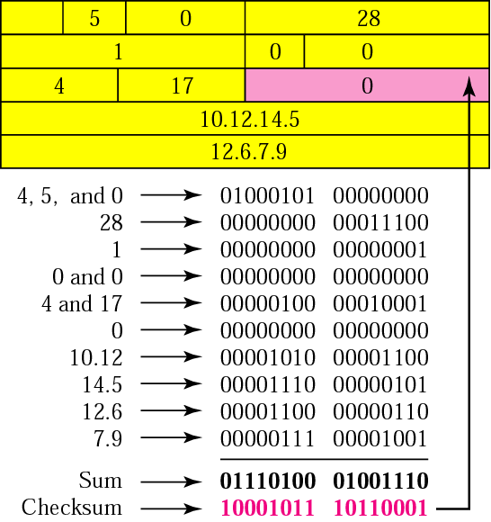
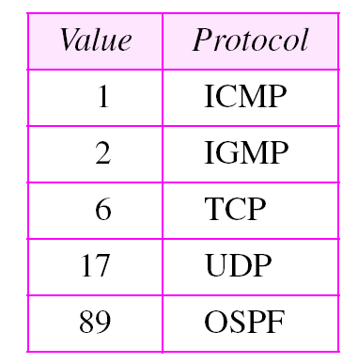
Example-Sender
Without options
- <number> -

Slide 9
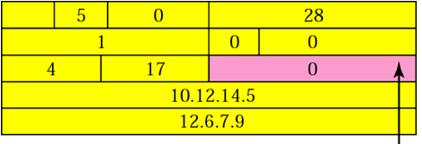
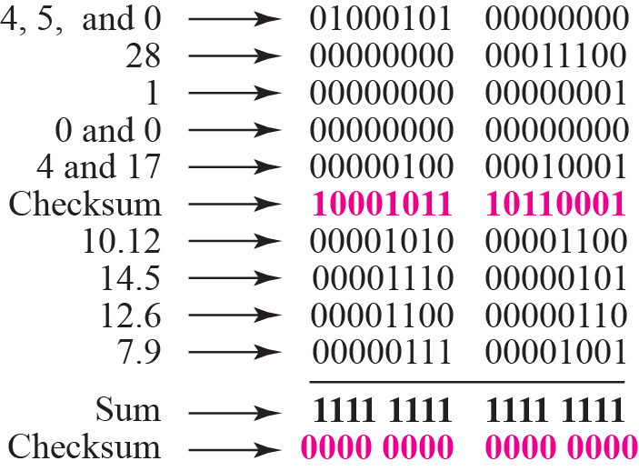
Example-Receiver
35761
- <number> -

Slide 10
UDP/TCP Checksum
UDP/TCP checksum calculation is different from the one for IP.
The checksum includes three sections
  A pseudoheader
  The UDP or TCP header
  The data coming from the application layer
- <number> -

Slide 11
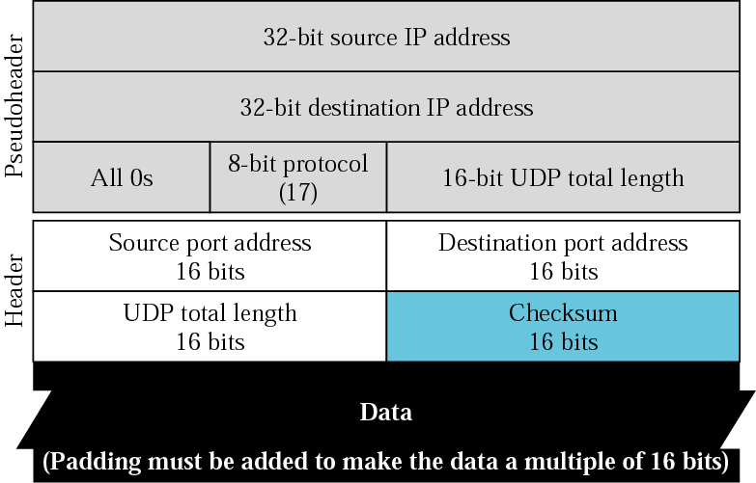
Pseudoheader for UDP
- <number> -

Slide 12
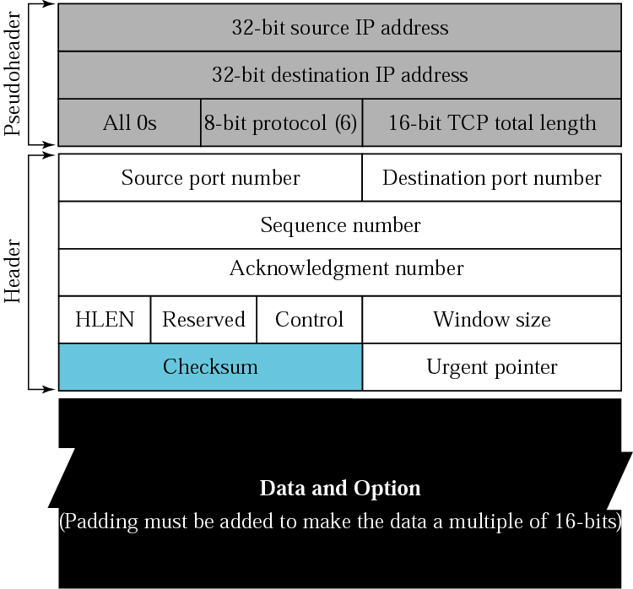
Pseudoheader for TCP
- <number> -

Slide 13
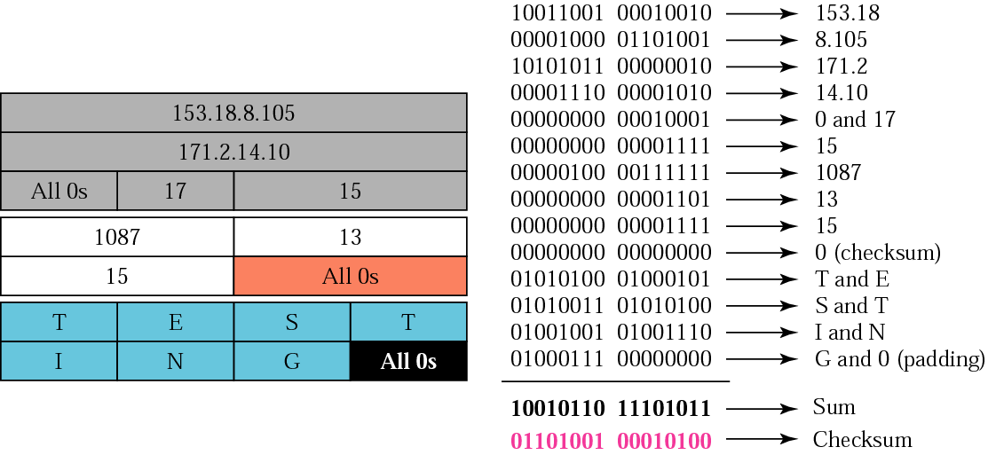
Example of UDP
- <number> -

